Slide 1

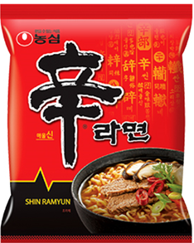
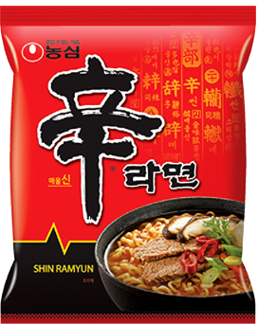
TAMTAM NOODLES
DELICIOUS FLAVOURS

Slide 2
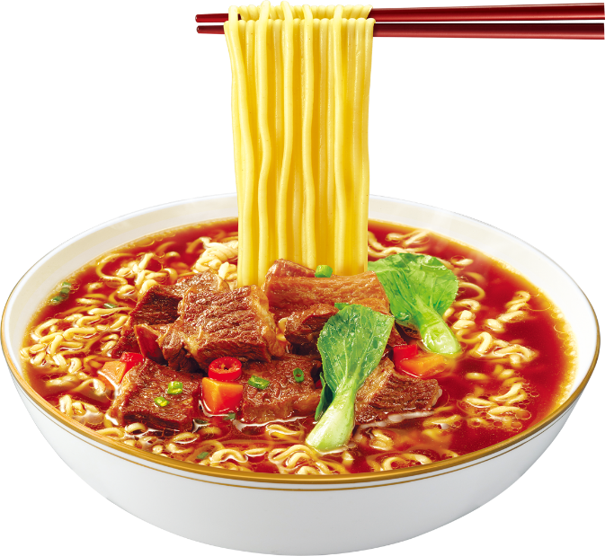
Latest flavors
Beef flavor
Egg flavor
Sea flavor
Chicken flavor

Slide 3
THANK YOU!

